Slide 1

3D Virtual Reality Painting

Slide 2
Purpose
The Alpha Build
Create a usable prototype to build on within each layer of the program
Prove function interaction between layers

Slide 3
Goals
Create basic UI structure
Working prototype of world editor
Working backend running rudimentary tests
Provable communication between front, middle and back end layers of the program

Slide 4
The Front End

Slide 5
Where we are
Created basic UI framework
Test functions in the UI
Structure 3D UI interaction
Basic HMD and controller support

Slide 6
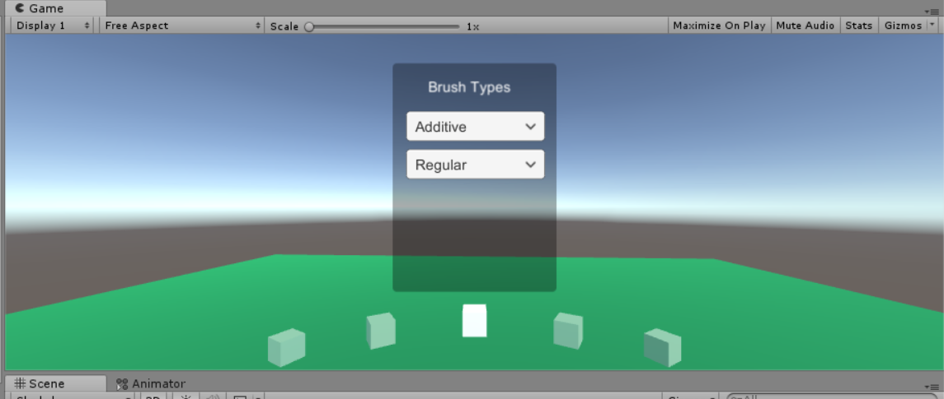

Slide 7
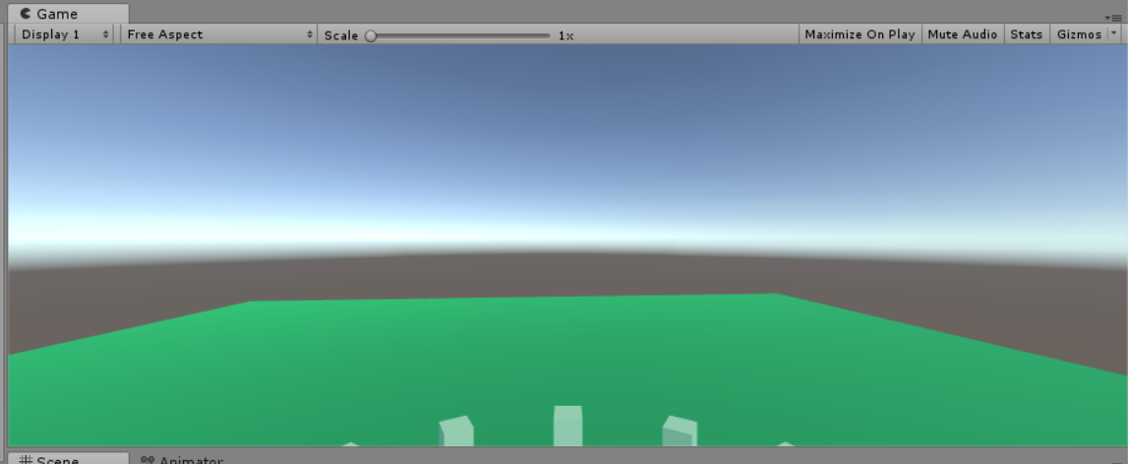

Slide 8
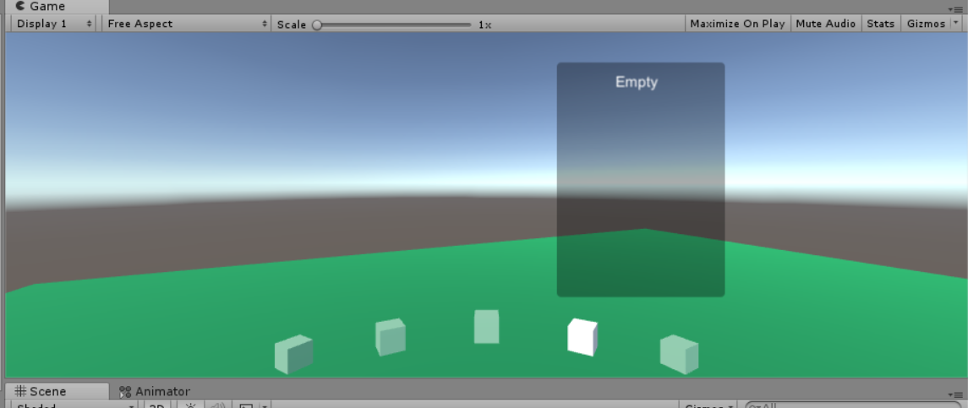

Slide 9
What is left to do
Create all buttons and functions for beta
Hook up UI buttons to Middle layer
Use VR controllers in conjunction with UI
Animate UI transitions

Slide 10
Problems
Limited access to VR equipment

Slide 11
Potential Solutions
Acquire personnel HMD and controllers
Acquire VR compatible machine

Slide 12
The Middle End

Slide 13
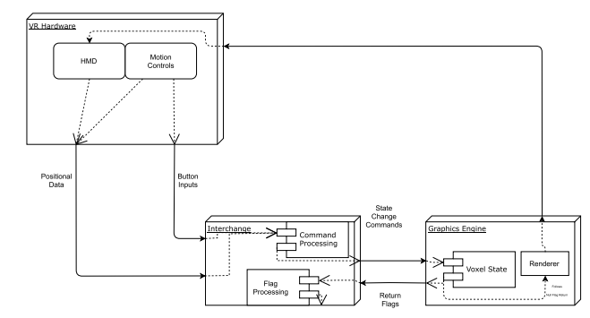
My Responsibilities

Slide 14
Where we are at
Basic voxel functionality
Create and destroy blocks
Create blocks of different color
Change the color of existing blocks
VR capable

Slide 15
How far are we?
System is a working voxel engine
Create/Destroy/Modify voxels
Some minor VR support

Slide 16
Development
Uses techniques common to voxel-based programs
Customized code to be better optimized

Slide 17
How it all Works
The scene generates an a world corresponding to an array
The scene loads sections of the world closest to the user
The scene renders any voxels visible to the user
The user changes the scene state, and the system updates the render

Slide 18
What is left to do
Finish implementing VR motion controls
Implement a save/load feature (will come after Yggdrasil)
Redesign rendering code

Slide 19
Problems
Designing code that won’t be obsolete in two weeks
Preparing for a new renderer
Getting motion controls to work

Slide 20
Potential Solutions
Make the code modular enough to change
Really not much else. The back end will be replaced by Yggdrasil

Slide 21
What comes next?
Prepare for the beta build of Yggdrasil
Finish block hierarchy system
Complete VR integration

Slide 22
The Back End

Slide 23
My Responsibilities
Make a GPGPU data storage and processing framework that
Stores and manages the state of the environment
Can render the state of the environment
Can execute brush operations on the environment
Yggdrasil

Slide 24
The Data Buffer
Initial State
Heap 0
Heap 1
...
Heap N
Block 0
Block 1
...
Block N
Node
Node
Node
Node
Node
Node
Node
Node
...
...
…
...
Node
Node
Node
Node
Mid-use State
Heap 0
Heap 1
...
Heap N
Block 0
Block 1
...
Block N
Node
Node
Node
Node
Node
Node
Node
Node
...
...
…
...
Node
Node
Node
Node

Slide 25
The Heap Buffer
6
3
...
...
...
Head
Count
Head
Count
...
...
...

Slide 26
The Block Buffer
Block 0
Block 1
...
Block N

Slide 27
The Task Buffer
6
3
...
...
...
Head
Count
Head
Count
...
...
...

Slide 28
Initialization
Task Queue 0
Task Queue 1
...
Task Queue N
Initial State
Heap 0
Heap 1
...
Heap N
Node
Node
Node
Node
Node
Node
Node
Node
...
...
…
...
Node
Node
Node
Node

Slide 29
The Memory Manager
5
4
4
3
Head
Count
Head
Count
Head
Count
Head
Count

Slide 30
The Ray Tracer
Sample 0
Sample 1
Sample 2
Sample 3

Slide 31
The Tool Executer
Exit
Find the Smallest Voxel Bounding the Stroke
Requires further depth?
Determine New Voxel Data
Nodes Need to Be Freed?
At maximum depth?
Traverse Deeper
Free Nodes
At Root Node?
Yes
No
Injected Code
Node Allocation Required?
Traverse Higher
Allocate Node

Slide 32
Problems & Progress
Lack of GLSL Compute Support by Unity → Port to HLSL
Vulkan Support by Unity → Remove Vulkan Capabilities from Build
Unity Defaults to RWStructuredBuffers → Change RWBuffers to RWStructuredBuffers

Slide 33
Where we are
Majority of GPGPU programs have full prototypes coded and compiling
Tree Manager and Tool Executer have yet to be fully coded
Input and output can be reliably made with compute shaders

Slide 34
What is left to do
Become Feature-Complete → Verify Operation of all Required Components
Initialization
Diagnostic
MemoryManager
RayTracer
Tool Executer
Exchange
Refinement
Lower memory footprint
Faster processing
Additional Features
Realistic alpha with overlapping blocks
Dynamic Lighting

Slide 35
Final Remarks

